Slide 1




Language Models (LLMs) based Reasoning Opportunities & Pitfalls
Asim Munawar
IBM TJ Watson Research Center , New York
Talk given on
22 Nov 2024 at

Slide 2
Outline
Introduction
Reasoning with LLMs
Evolving trends
Improve reasoning
IBM’s Play
Conclusions

Slide 3

What LLMs are, and what they are not?
Transformer Architecture
Published in 2017
https://arxiv.org/abs/1706.03762

Slide 4
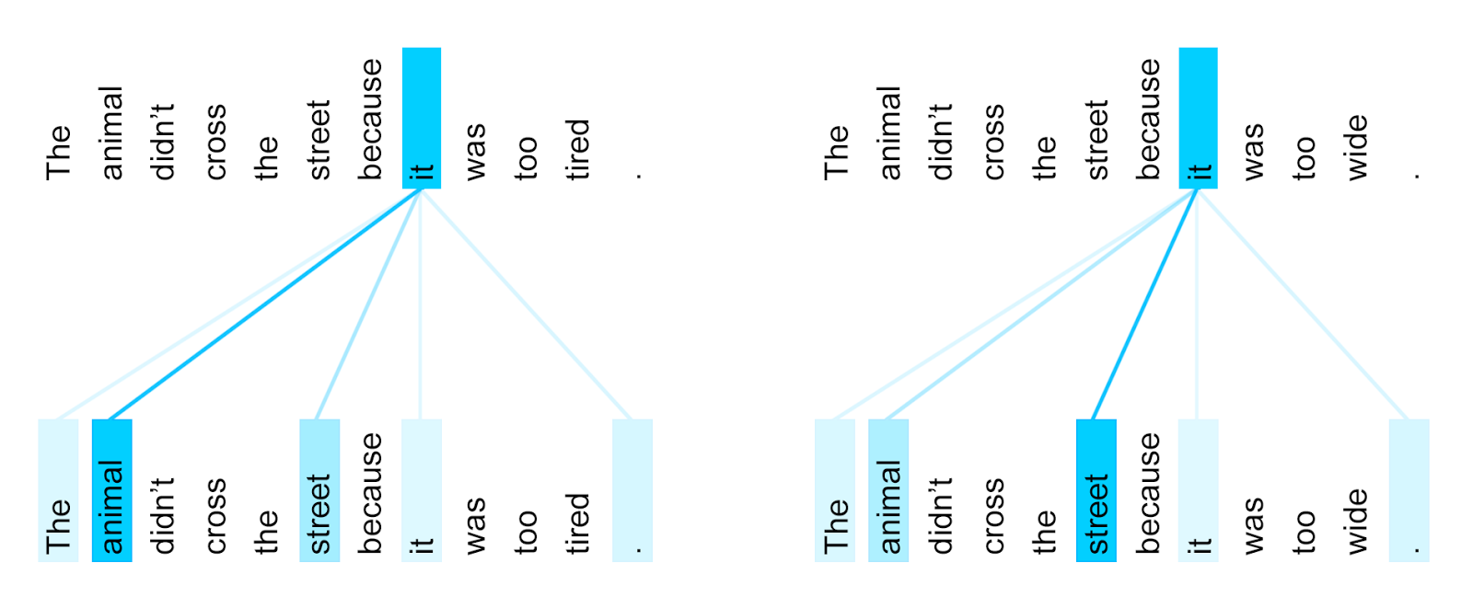
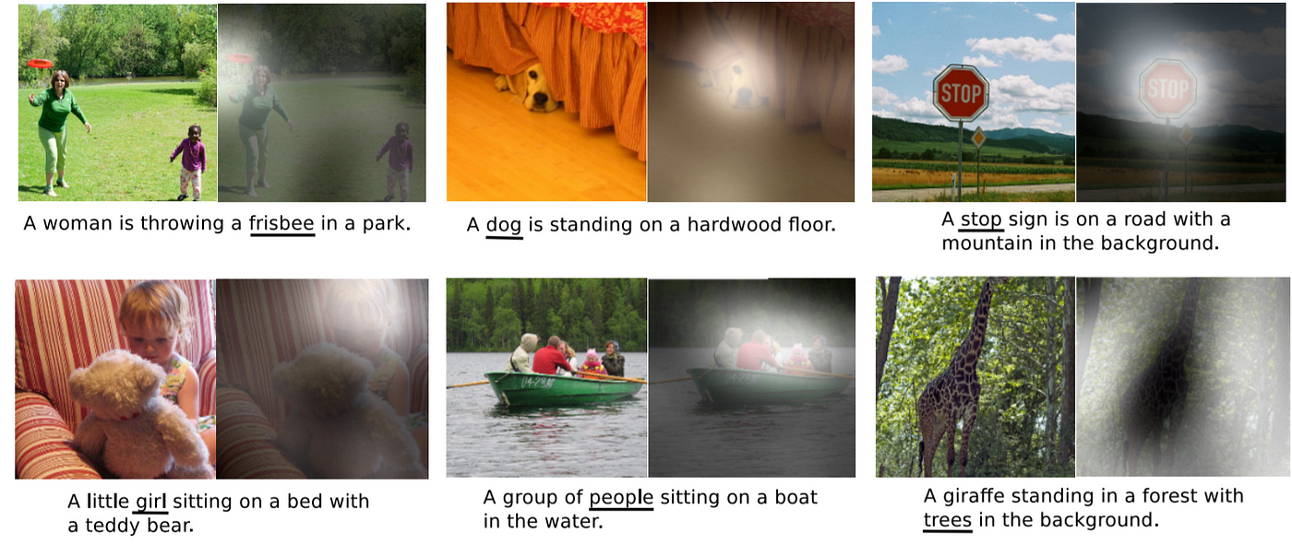
Attention
The attention allows models to focus on specific parts of input data while making predictions or generating outputs
Image source: Uszkoreit (2017)
Image source: Xu et al. (2015)
Encoder self-attention distribution for the word 'it' in different contexts.
Notes:
Uszkoreit, Jakob. 2017. "Transformer: A Novel Neural Network Architecture for Language Understanding." Google AI Blog, August 31. Accessed 2019-11-14.

Slide 5
Transformer Architecture
Tokyo
Next Word
Numeric Encoding
LLMs are next token predictors
Decoder
Encoder
Input
Target
What is the capital of Japan?
<Start>

Slide 6

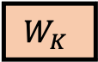
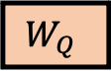
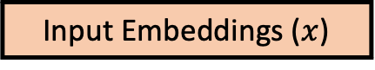
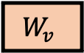
Self Attention
Key | Value
Name | Asim Munawar
Employer | IBM
Address | New Jersey
… | …
Tokyo
Next Word
Intuitive explanation
Q:Query is the query/question (e.g., what is the full name?)
K:Key is the label (e.g., name field in a form)
V:Value is the actual string under the label (e.g., Asim Munawar)
Numeric Encoding
Decoder
Encoder
$$W_{Q}$$
$$W_{K}$$
$$W_{v}$$
Input
Target
What is the capital of Japan?
<Start>
Input Embeddings ($x$)

Slide 7

Reasoning with Large Language Models (LMMs)

Slide 8
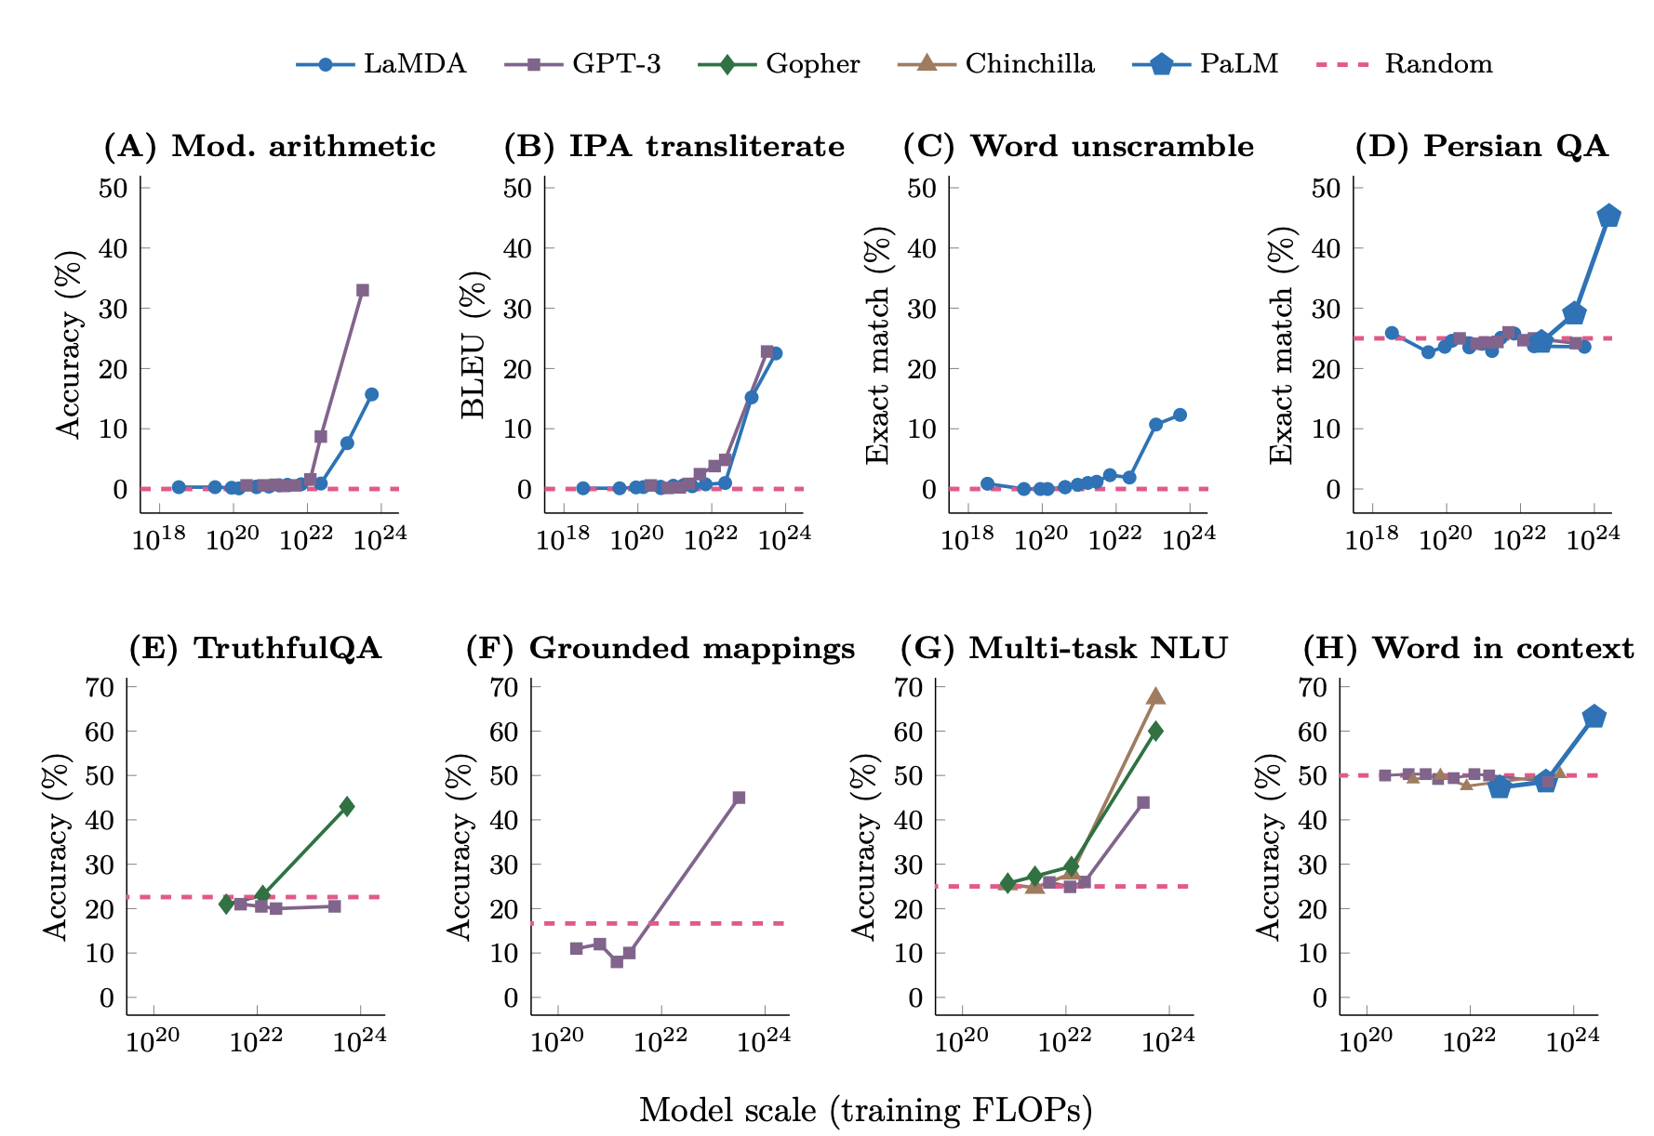
What is Reasoning?
Reasoning is the process of thinking about something in a logical and systematic way, using evidence and past experiences to reach a conclusion or make a decision.
Formal Reasoning
Symbolic logic, math
Precise, rule-based
Challenges: complexity, real-world ambiguity
Natural Language Reasoning (aka. Informal Reasoning)
Human-like understanding
Contextual, nuanced
Challenges: ambiguity, subjectivity
An emergent property of LLMs?
Training FLOPs
Number of model parameters
Training data size
Emergent Abilities of Large Language Models,Jason Wei et al.

Slide 9
Vs.
Knowledge
Drawn from past experiences and stored information.
Example: Recognizing a wet umbrella as an object we've encountered before.
Reasoning
The ability to think step by step and infer new conclusions from existing clues.
Example: Seeing a wet umbrella near the door, we deduce:
It’s raining outside.
Someone arrived home a few minutes ago.
Difference
While knowledge relies on what we already know, reasoning enables us to make sense of incomplete information and answer questions beyond what’s explicitly given.

Slide 10
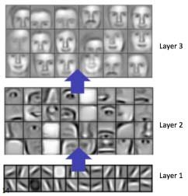
Explainability in LLMs (and deep learning in general) Model agnostic methods
Explainability (aka. Interpretability), is crucial for understanding and trusting complex models like LLMs and deep neural networks.
Global Explainability
Understanding the overall behavior of the model.
Analyzing the structure of the model to gain insights to capabilities and limitations.
Determine which input features contribute most to the model's output.
Local Explainability
Why did the model make this particular decision?
Instance-Based Explanations: Explaining the prediction for a single data point.
Counterfactual Explanations: Identifying what would need to change in the input to alter the model's prediction.
https://arxiv.org/html/2401.13110v1

Slide 11
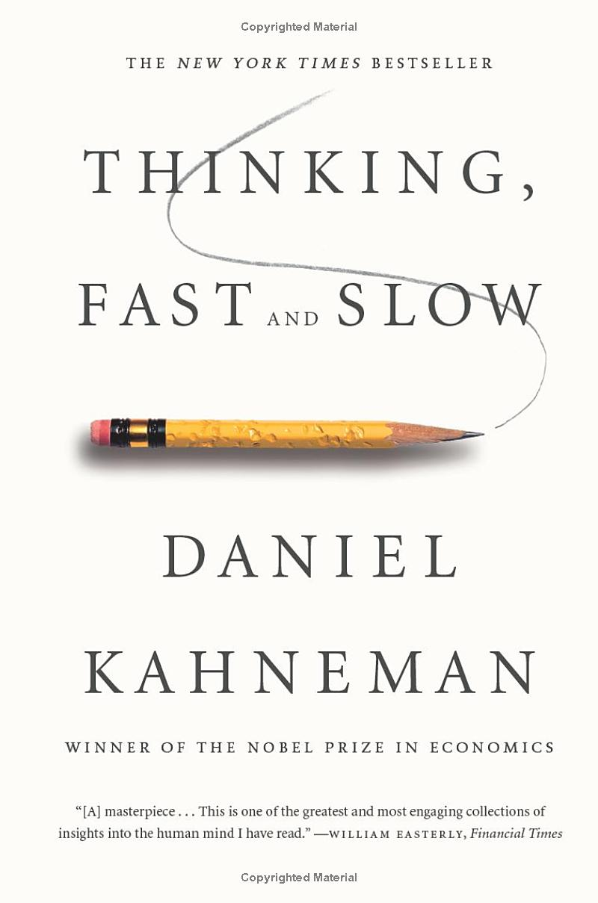
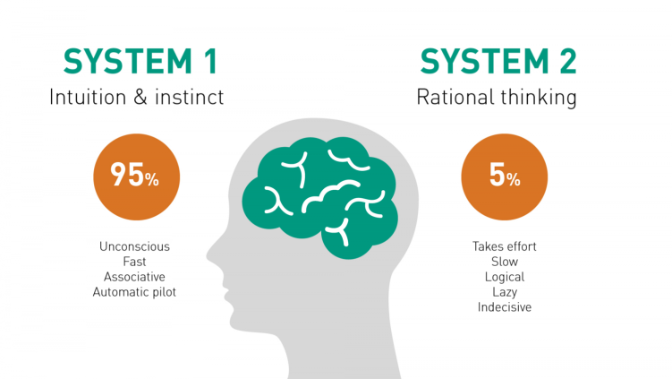
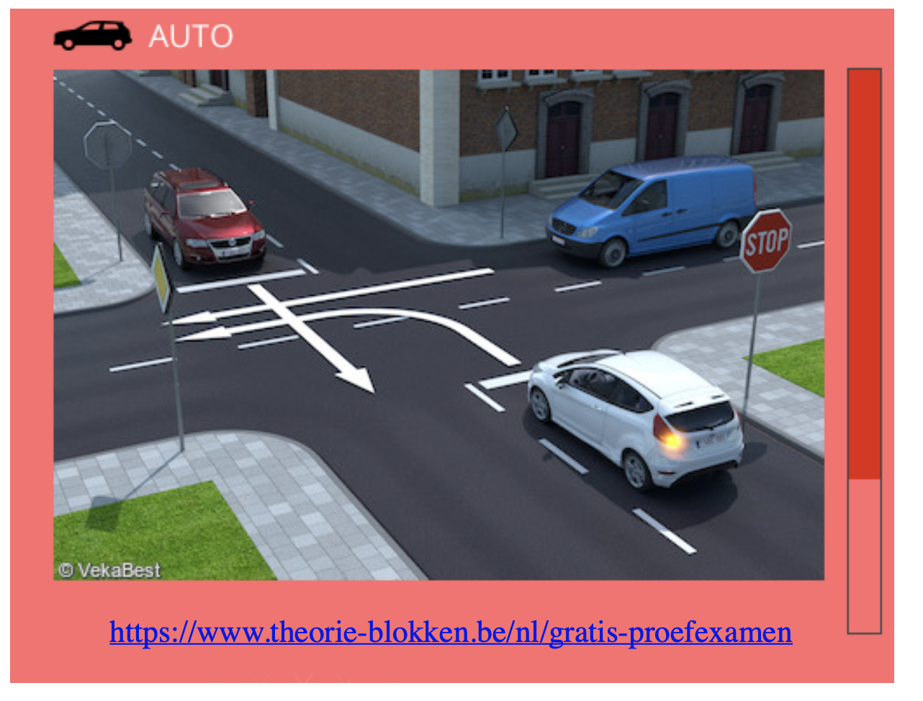
Thinking Fast and Slow
Real-life problems involve both
Aka.
Data-driven vs. knowledge driven
Symbolic vs. sub-symbolic
Neuro-symbolic
Who can go first? A. The red car
B. The blue van
C. The white car
Thinking Fast
Can do things like 2+2=?
Recognize objects in images
Thinking slow
Can reason about solving complex problems – planning complex tasks
Source: https://www.linkedin.com/pulse/brain-system-1-2-faraz-ehjaz/
Source: Luc De Reaedt’s talk in NS Summer School 2023
Notes:
System 1 and System 2
The psychologist Daniel Kahenman popularized two kinds of thinking: System 1 and System 2. Yan LeCun and others have been very clear. If deep neural networks are doing anything like reasoning at all, it’s strictly System 1. That’s not an intuitive judgement, either, the research bears this out. Deep neural networks are not doing symbolic reasoning (a little louder for the breathless folks in the back).
System 1: Fast, Automatic Reasoning
Automatic: Processes information automatically without conscious control.
Fast: Decisions and assessments are made quickly.
Heuristic-based: Often relies on rules of thumb, mental shortcuts, or stereotypes.
Emotion-driven: Emotions and gut feelings can heavily influence decisions.
Effortless: Requires little or no cognitive effort.
Examples: Recognizing faces, reading emotions, basic arithmetic like 2+2, and simple motor skills are often driven by System 1.
System 2: Slow, Deliberative Reasoning
Conscious: Requires active, deliberate cognitive effort.
Slow: Takes time to process information and make decisions.
Logical: Tends to rely on formal methods of reasoning, following rules or structured approaches.
Resource-Intensive: Consumes more cognitive resources and energy.
Controlled: Can follow rules, compare options, weigh pros and cons, and reason logically.
Examples: Solving complex math problems, making high-stakes decisions, and evaluating complicated situations typically involve System 2 reasoning.
Somehow, humans do both. Though, if you watch the same YouTube channels my kids do, you might wonder if humans do any System 2 at all. But let’s be generous.
System 1 + 2
Statistical models of intelligence like deep neural networks roughly equate to System 1 thinking. Symbolic models of intelligence roughly equate to System 2 thinking. The field of neurosymbolic AI is looking for ways to create intelligent systems with System 1 and System 2 capabilities. Call it the holy grail of machine intelligence, just one more next step in machine intelligence, call it J.A.R.V.I.S. Whatever it is, the promise is huge. Uniting the strengths of statistical and symbolic AI in a fully integrated way really could give us systems that learn on their own, truly reason, solve a wider range of problems, and do so in a way that is more interpretable and explainable to us. Or so the theory goes.
It's a great theory. Many of the biggest names in AI research seem to think so. And the more I read the more interested I get. The possibilities are exciting. But even more, it’s an intellectually exciting goal.

Slide 12
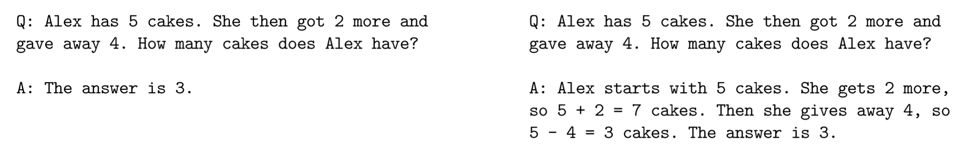
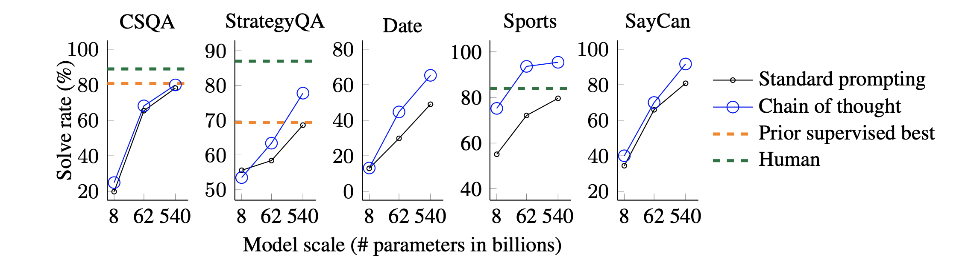
Chain of Thought (CoT) Reasoning A method for natural language reasoning
Step-by-Step Reasoning
Improving Accuracy
Transparent and Interpretable
Debugging and Refinement
Standard prompting
Chain-of-thought prompting
[Wei et al 2022]

Slide 13
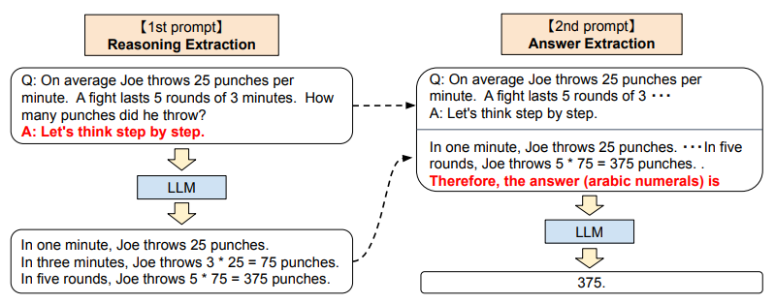
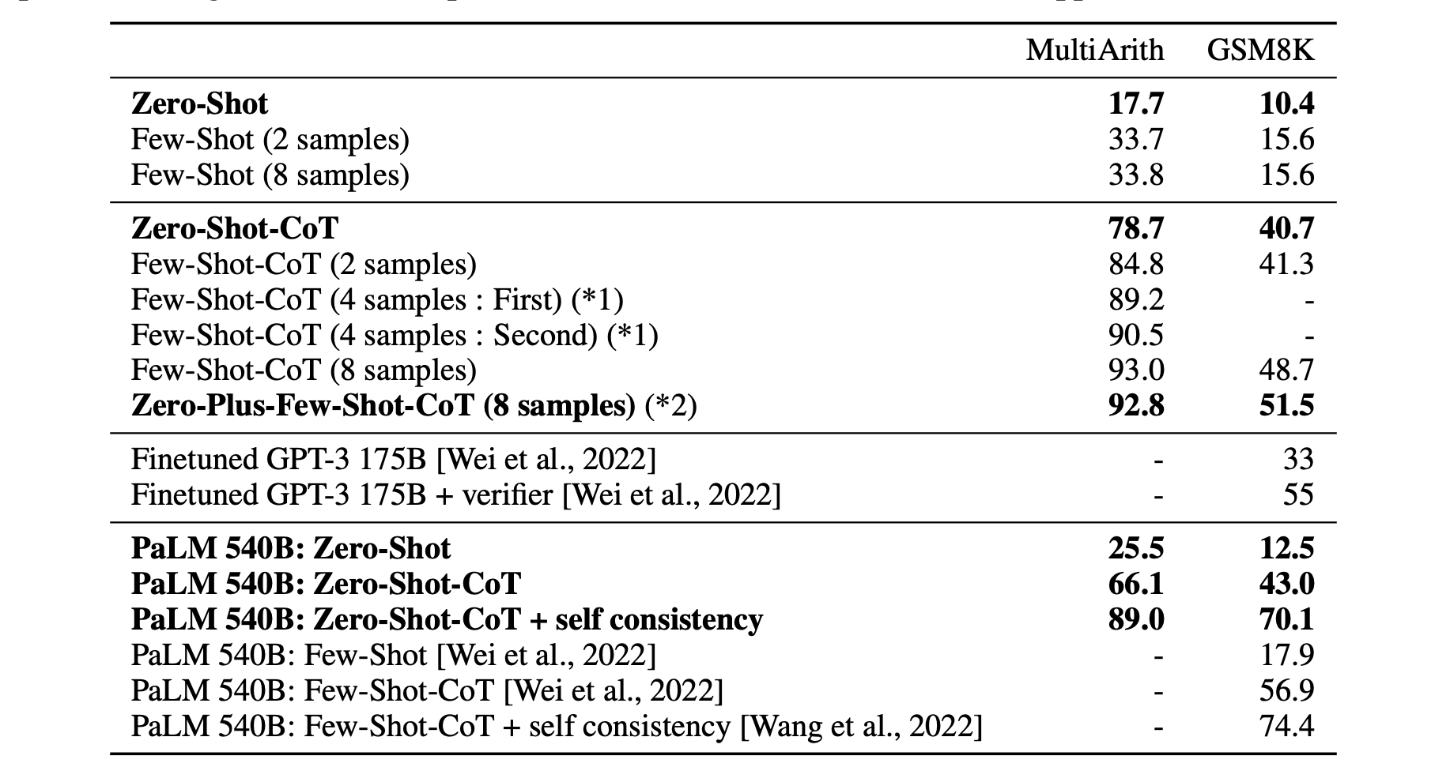
Zero-Shot CoT
Zero-Shot CoT results for text-davinci002 6B
Large Language Models are Zero-shot Reasoners (Jan 2023) -- https://arxiv.org/pdf/2205.11916.pdf

Slide 14

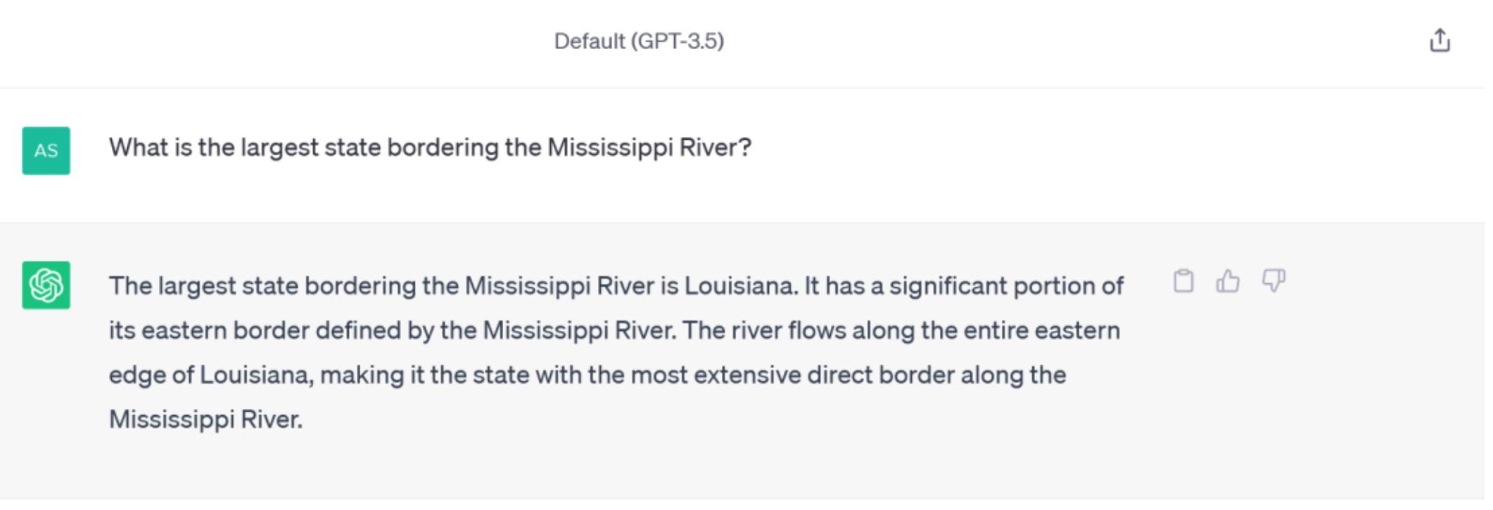


Zero-shot CoT
[Kojima et al 2022]

Slide 15
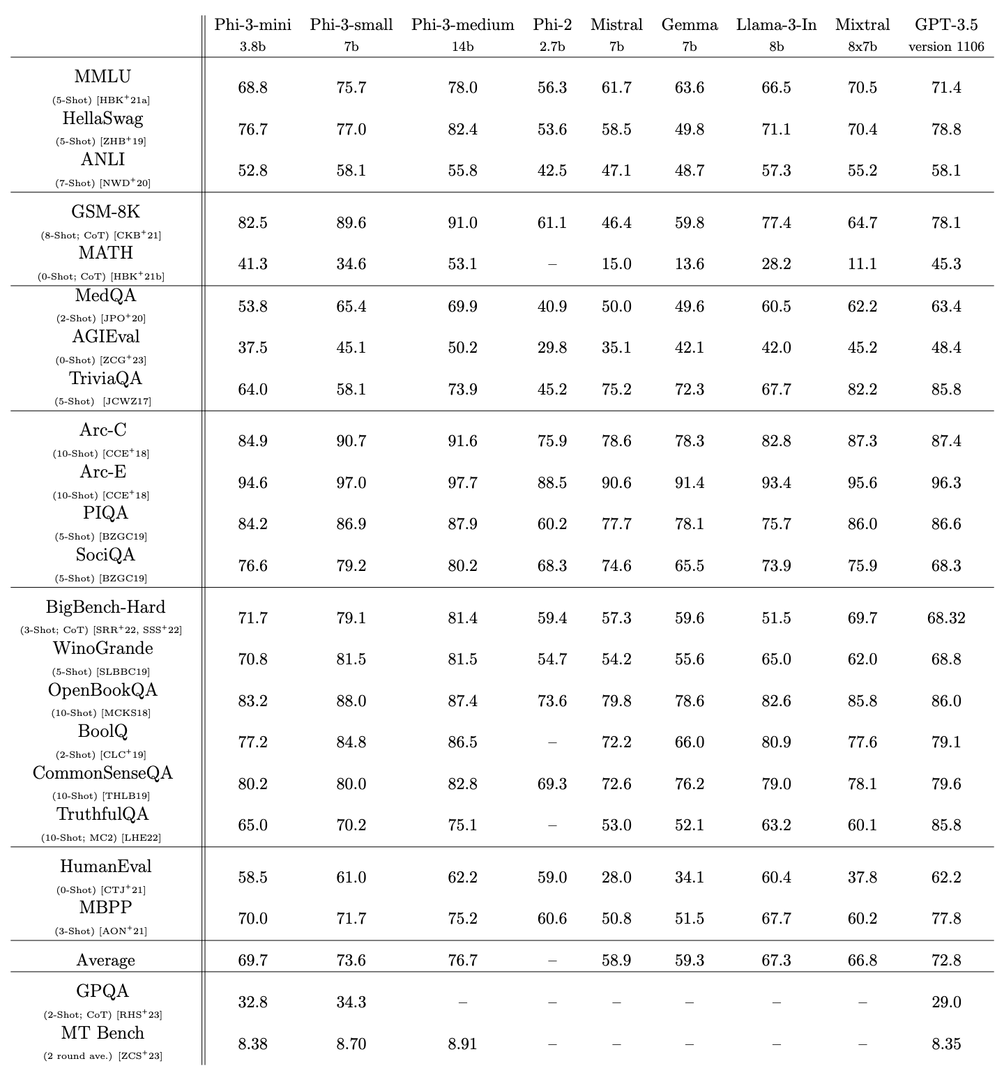
So, are LLMs able to Reason?
LLMs do perform well on many benchmarks, sometimes better than non-expert humans
Dataset | Full Name | Description
gsm8k_cot | Grade School Math 8K (Chain of Thought) | Grade-school math problems requiring step-by-step reasoning for solutions.
bbh_cot_fewshot | Big Bench Hard (Few-shot Chain of Thought) | Challenging reasoning tasks with few-shot chain-of-thought prompts.
ai2_arc | AI2 Reasoning Challenge | A question-answering benchmark testing scientific and commonsense reasoning.
mmlu | Massive Multitask Language Understanding | Multi-task benchmark for language understanding across diverse knowledge domains.
commonsense_qa | Commonsense Question Answering | Multiple-choice questions assessing everyday commonsense knowledge.
hellaswag | HellaSwag Commonsense Completion | A commonsense reasoning task for choosing the most plausible sentence continuation.
openbookqa | OpenBook Question Answering | Open-book multiple-choice questions assessing science and general knowledge reasoning.
piqa | Physical Interaction Question Answering | Physical reasoning task focusing on everyday physical interactions and intuitive physics.
race | Reading Comprehension Dataset | Reading comprehension dataset with questions based on middle and high school exams.
social_iqa | Social Interaction Question Answering | Social commonsense reasoning tasks requiring understanding of interpersonal scenarios.
Abdin, M., et al. (2024). Phi-3 Technical Report: A Highly Capable Language Model Locally on Your Phone. arXiv. https://arxiv.org/abs/2404.14219

Slide 16
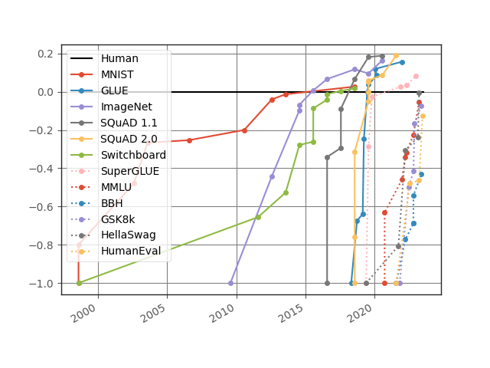
Potential Confounders
“LLMs can appear to reason but their core function is more like sophisticated pattern matching and information retrieval rather than true, human-like reasoning”
Subbarao Kambhampati - ASU
Some benchmarks focus on limited domains (e.g. Math)
Templated benchmarks can be deceiving
Contamination: reasoning ability or retrieval ability
May exploit artifacts and shortcuts
https://contextual.ai/news/plotting-progress-in-ai/

Slide 17
Evolving Trends in LLMs
Smaller specialized models
New architectures
Quantization
MoEs
Longer context length
Memory mechanisms
Alignment and Safety
RLHF → RLAIF
Agentic behavior
Train time vs. Test time compute
Synthetic Data

Slide 18
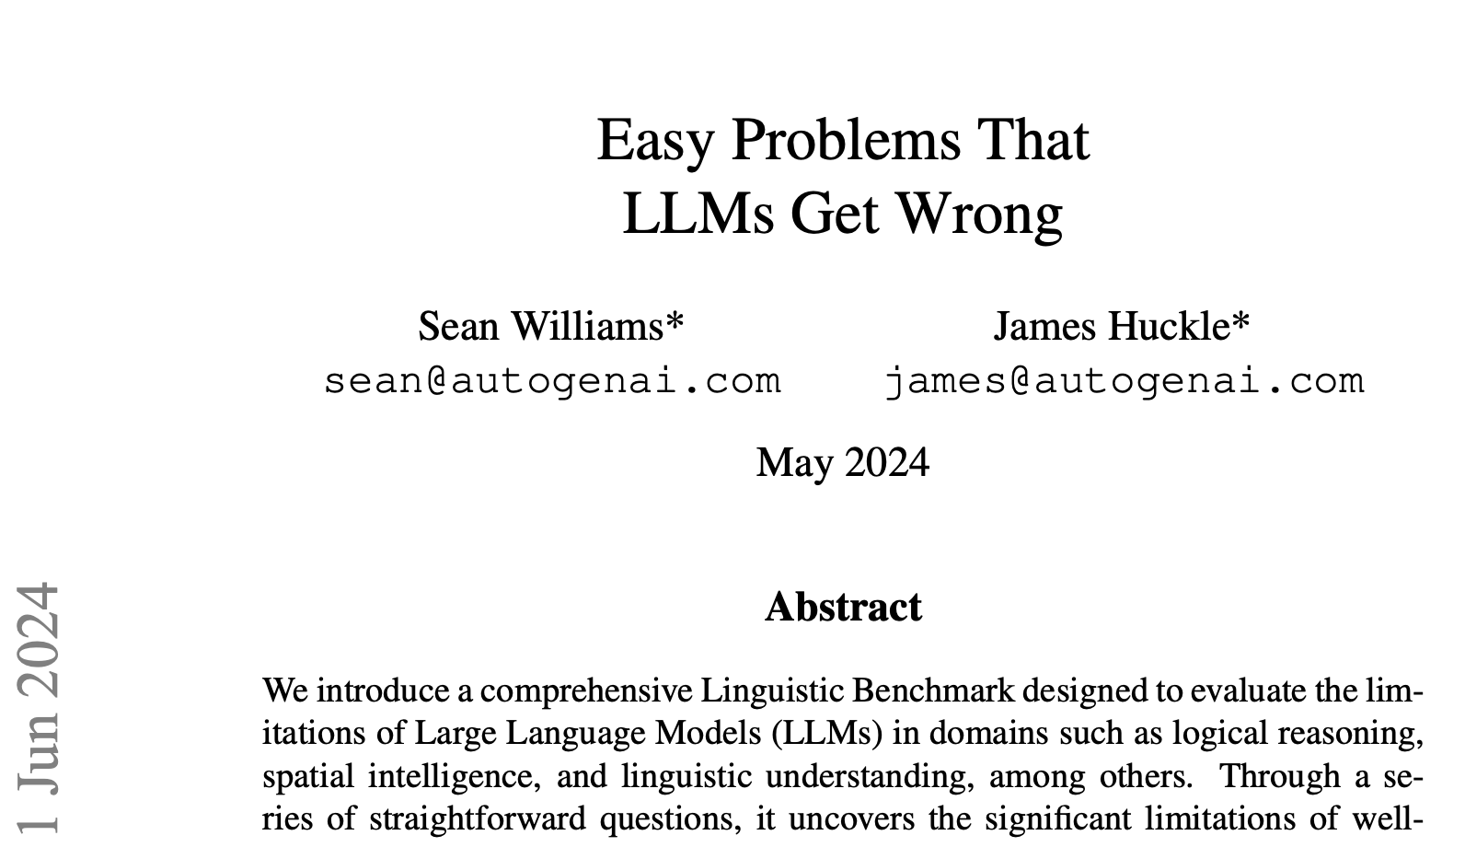
Improving LLMs on Reasoning by Synthetic Data Generation
Question: Count the number of occurrences of the letter ’L’ in the word - ’LOLLAPALOOZA’.
GPT-4 Turbo Answer: “... There are 5 ’L’s in the word ’LOLLAPALOOZA’”

Slide 19
Synthetic Data Generation for Reasoning Tasks
Algorithmic vs Non-Algorithmic Tasks
Algorithmic Tasks
Rule-based tasks with clear steps and predictable outcomes.
LLMs can assist by recognizing patterns and logic.
May need external tools for complex computations.
Examples: Math problems, coding, sorting, optimization.
Non-Algorithmic Tasks
Context-driven tasks with ambiguous or creative elements.
LLMs excels at language understanding, contextual reasoning, and generating human-like responses.
May need world model.
Examples: Summarization, conversation, creative writing, advice.

Slide 20
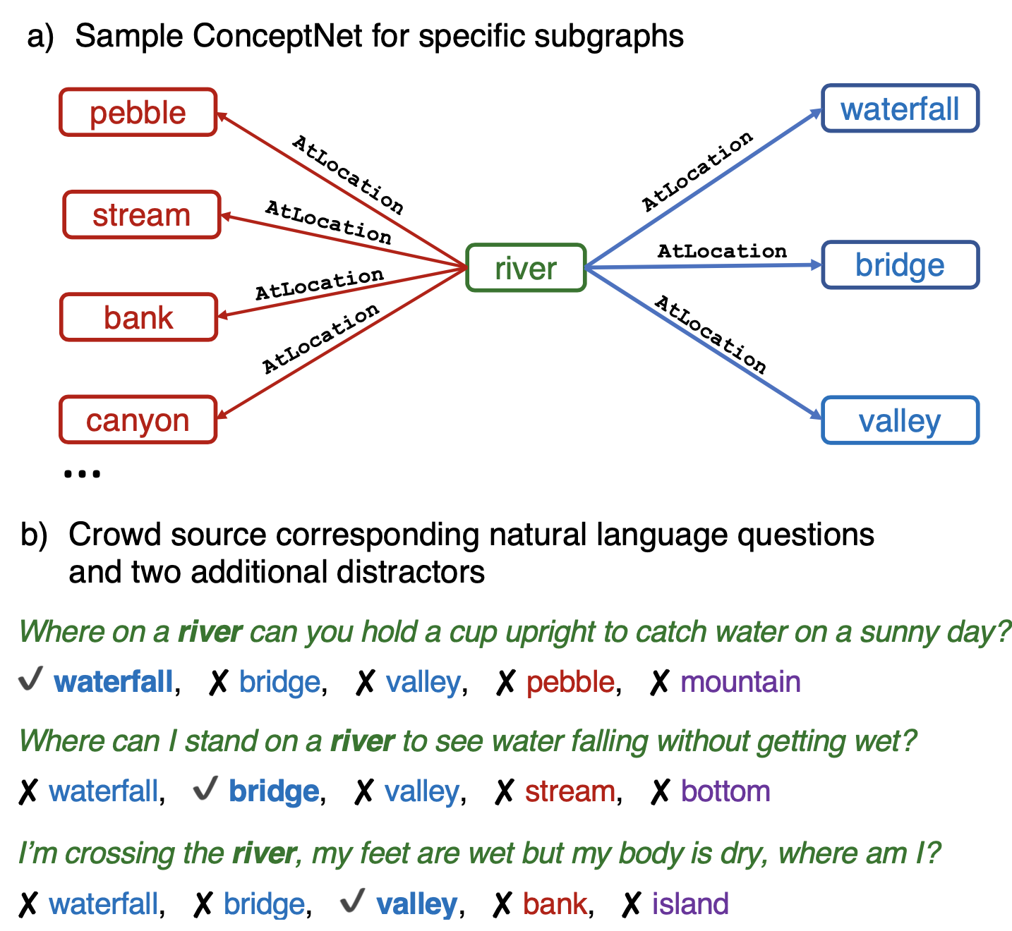
Knowledge Graphs (KGs) based SDG
LLMs are trained on a lot of unstructured text during pre-training phase
KGs on the other hand are much higher quality, and vast amount of information is encoded as graphs
KGs (e.g. common-sense KG like ConceptNet) cannot be used directly in pre-training
KGs can be noisy
Templated data can be toxic for LLMs
This will mainly help the non-algorithmic tasks
Alon Talmor et al., COMMONSENSEQA: A Question Answering Challenge Targeting Commonsense Knowledge (2019), arxiv: 1811.00937v2
Notes:
This encourages workers to create ques- tions with complex semantics that often re- quire prior knowledge.

Slide 21
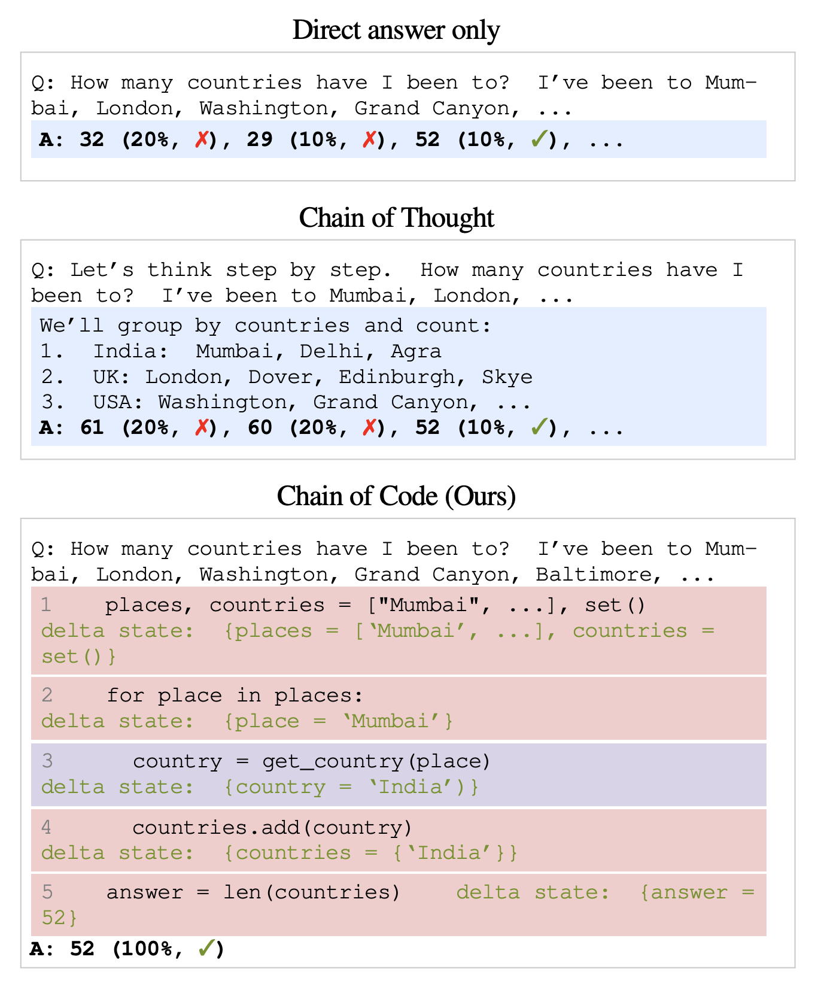
Code Assisted Data Generation
Chain of Code
We know that LLMs can be prompted to generate CoT reasoning as Text
LLMs are very good at generating code too
Works like Chain of Code can use reasoning and code for self-consistency
In our experience, this helps the algorithmic reasoning
Li, C., Liang, J., Zeng, A., Chen, X., Hausman, K., Sadigh, D., Levine, S., Fei-Fei, L., Xia, F., & Ichter, B. (2024). Chain of Code: Reasoning with a language model-augmented code emulator. arXiv preprint arXiv:2312.04474.

Slide 22
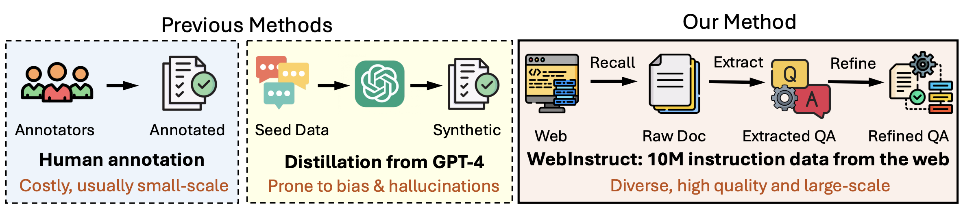
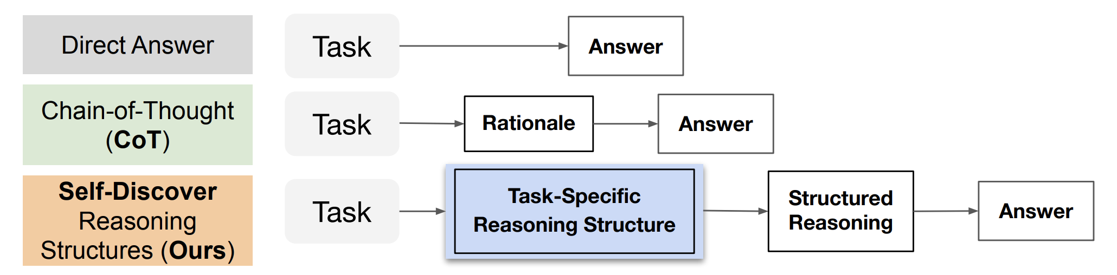
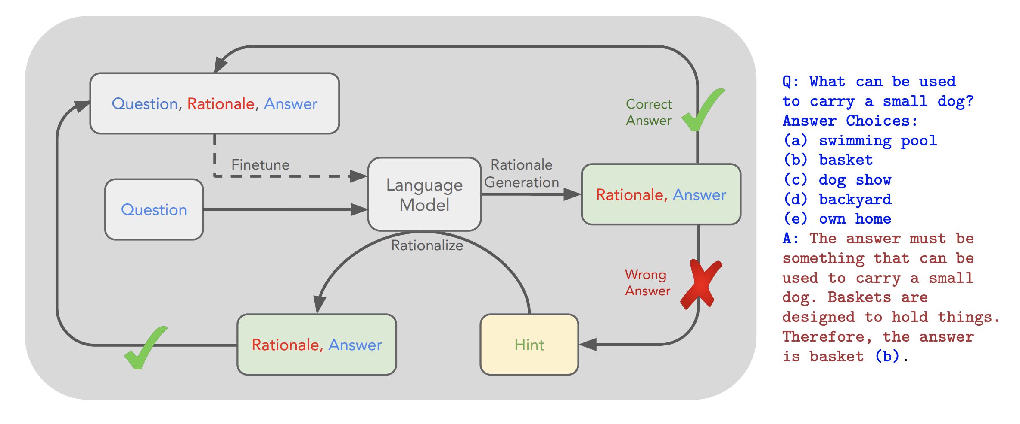
Pick topics from web crawls
MAmmoTH2: Scaling Instructions from the Web, Xiang Yue et al.
Complex reasoning for SDG
SELF-DISCOVER: Large Language Models Self-Compose Reasoning Structures Pei Zhou
Diverse High Quality Synthetic Data
Create Intermediate reasoning from Answers
STaR: Self-Taught Reasoner Bootstrapping Reasoning With Reasoning Eric Zelikman

Slide 23
Data Filtering – for higher quality Synthetic Data
As the data (gold, crawled, synthetic data) has been growing, so is the need for filtering of the data.
Common methods for filtering
Metrices based – e.g. Perplexity etc.
LLM as a judge – Prompting the model
Reward models (ORMs, PRMs)
Human Eval
Self consistency
Search
Semantic Deduplication
PII removal

Slide 24
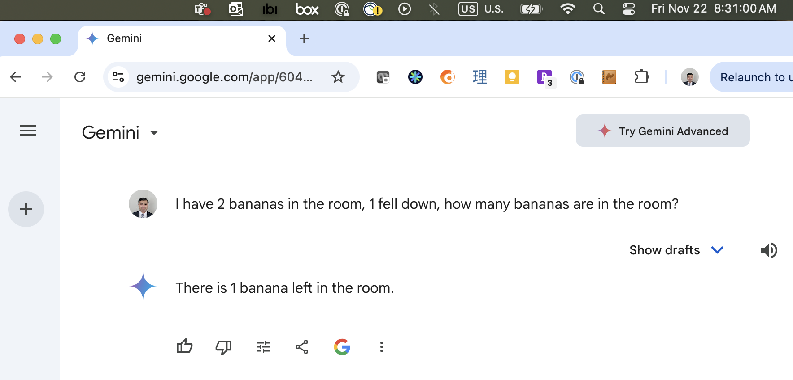
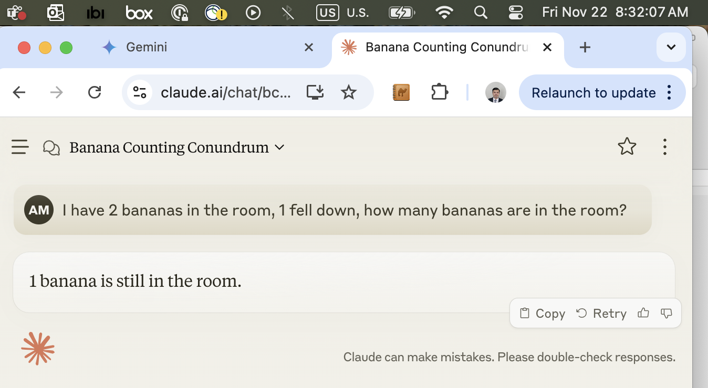
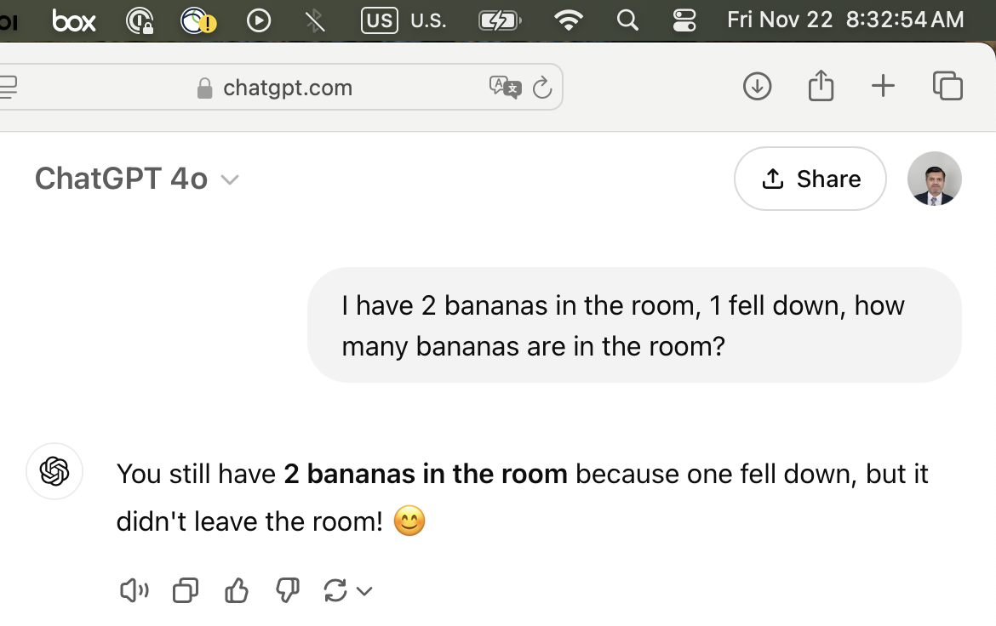
Future of Reasoning with LLMs
Neuro-Symbolic AI?

Slide 25

The Bitter Lesson
The bitter lesson is based on the historical observations that
AI researchers have often tried to build knowledge into their agents,
this always helps in the short term, and is personally satisfying to the researcher, but
in the long run it plateaus and even inhibits further progress, and
breakthrough progress eventually arrives by an opposing approach based on scaling computation by search and learning.
I couldn’t agree more ☺
[Sutton, 2019] Sutton, R. (2019)
Slide Inspired by: Sasha Rush – o1 tutorial

Slide 26
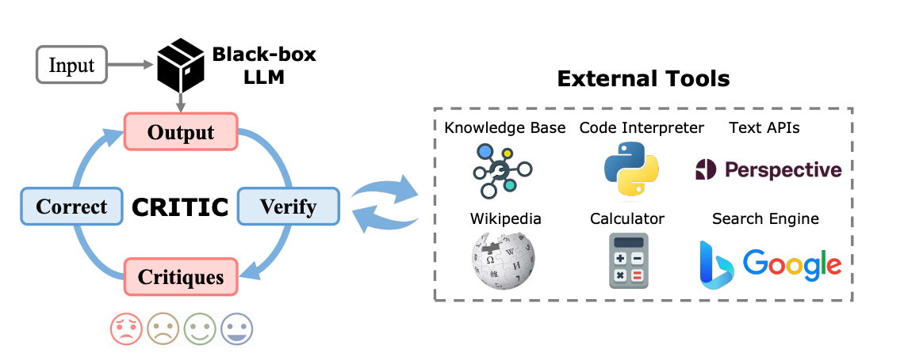
Agents
LLMs that can critique their own decisions and improve output
SWE agents have shown an incredible progress
Intermediate steps can be kept hidden from the user or shared for full explainability
A good agent excels in:
Reasoning/Planning
Tool use
https://one-piece.medium.com/llm-agents-revolution-unleashing-unprecedented-performance-with-the-agent-reflection-workflow-eb057305008a

Slide 27
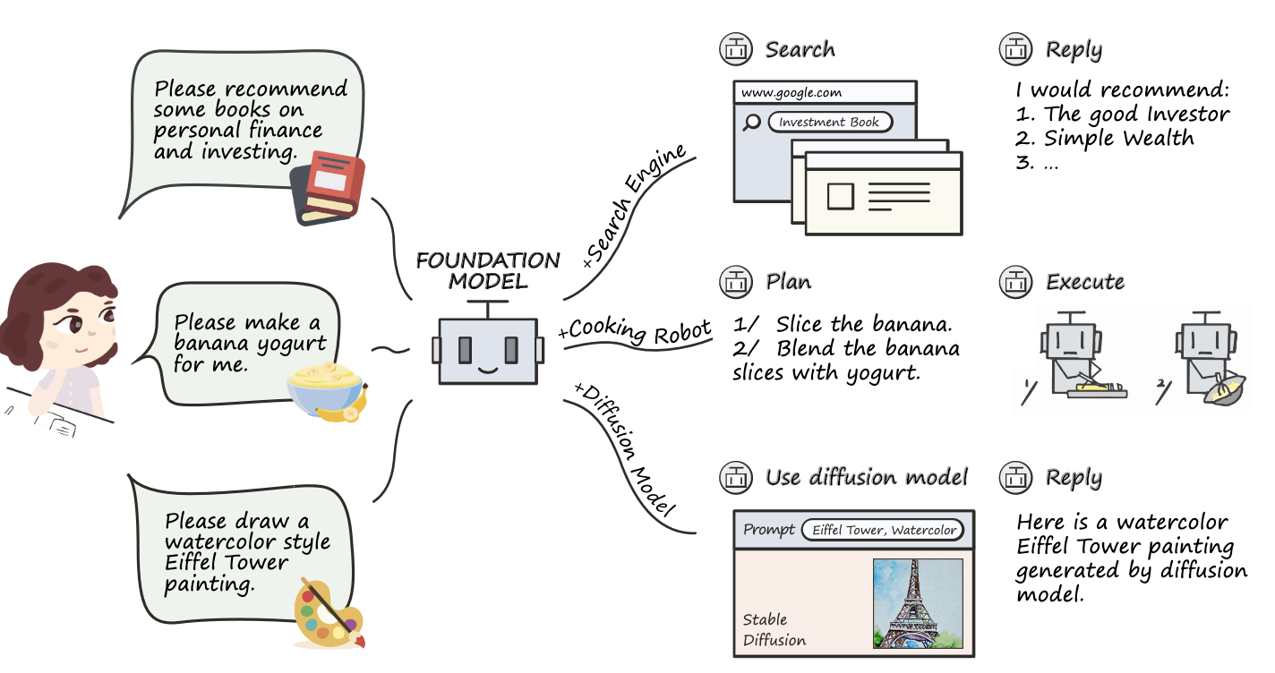
Improving LLMs on reasoning by teaching it to call Tools
Qin, Yujia, et al. "Tool Learning with Foundation Models." arXiv preprint arXiv:2304.08354 (2023)

Slide 28
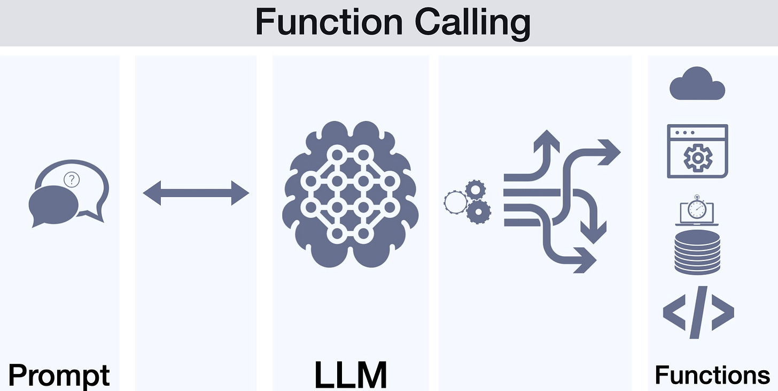
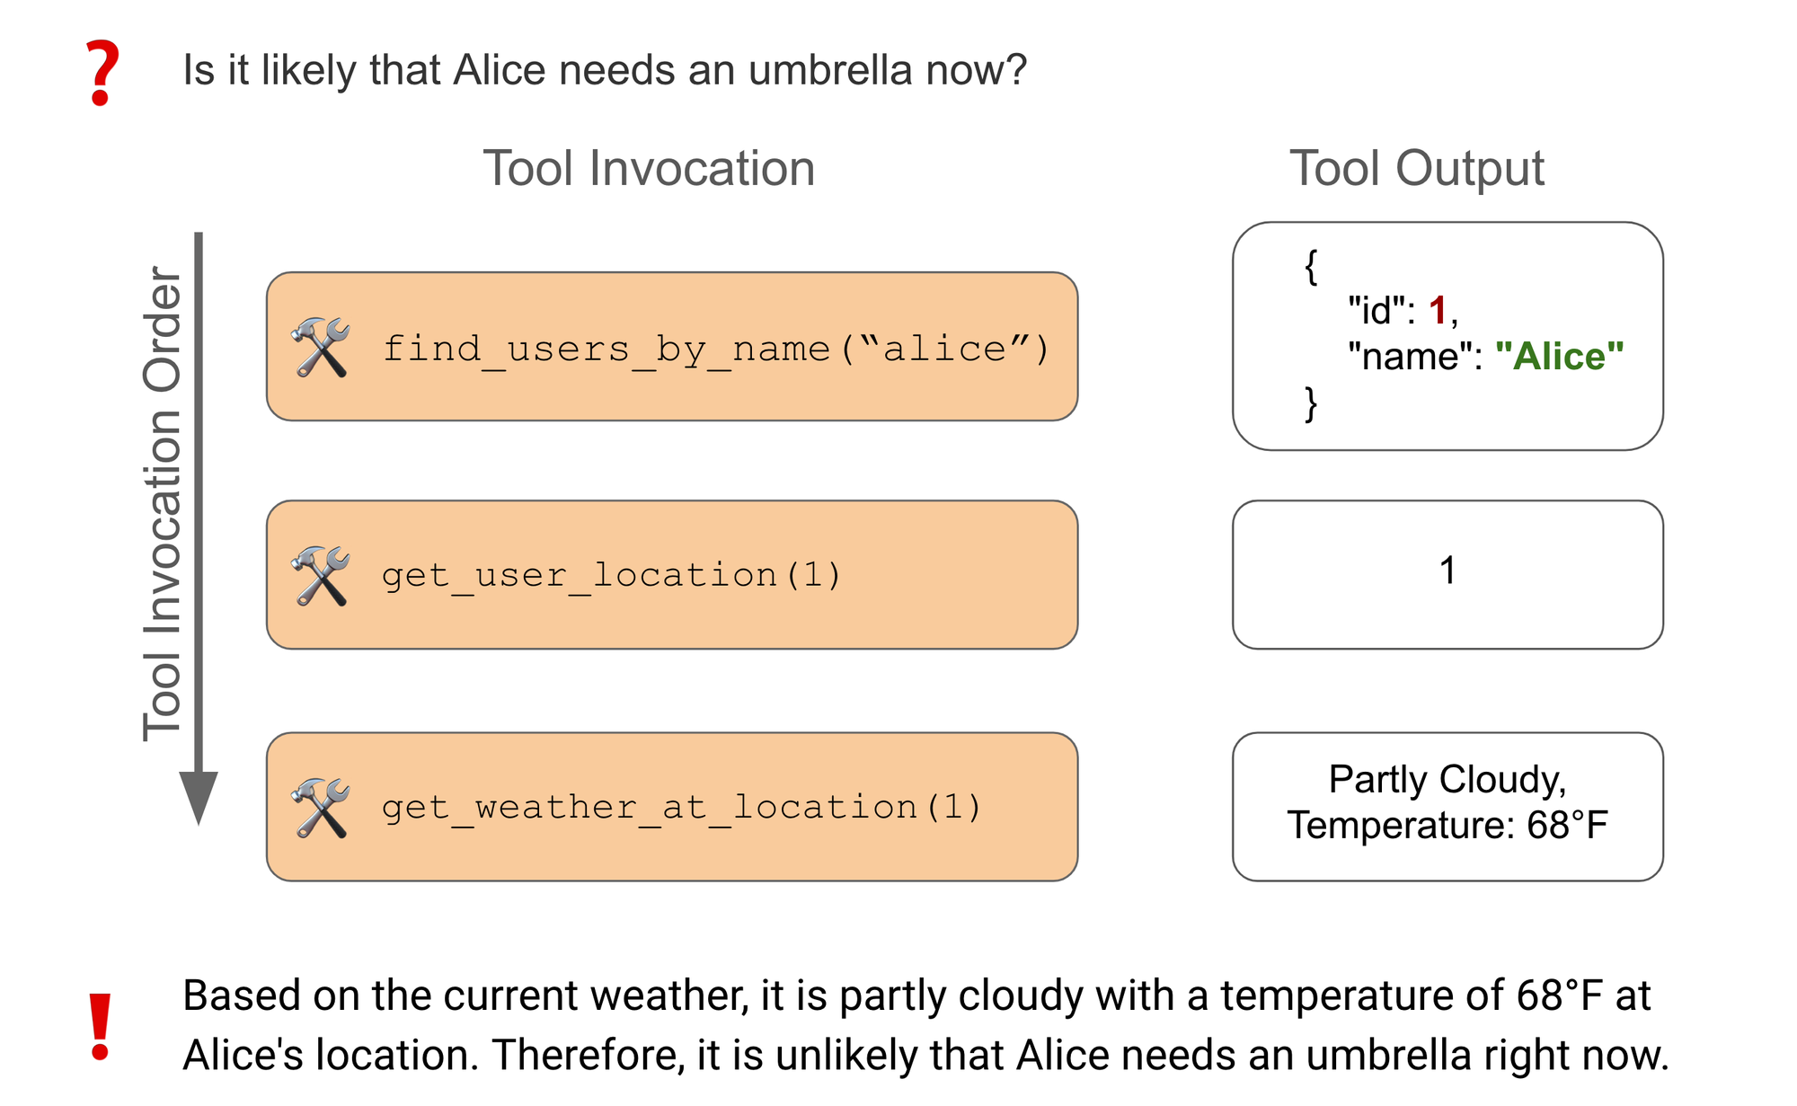
Feature | Description
API Detection | Function to call
Slot Filling | Parameters to pass
Sequencing | Order of calls
Nesting | Resolving interdependencies
Next Best Action | Diversity/Ambiguity
Personalized Responses | Retrieve and generate (RAG)
https://gradientflow.substack.com/p/expanding-ai-horizons-the-rise-of
https://blog.langchain.dev/benchmarking-agent-tool-use/
Notes:
So, how this works.
In addition to the instruction users usually give to the model, they also provide a library of function calls in OpenAPI specs, and then it’s up to the model to decide if any of these functions can be used to answer the user utterance and in what order
In the example ….

Slide 29
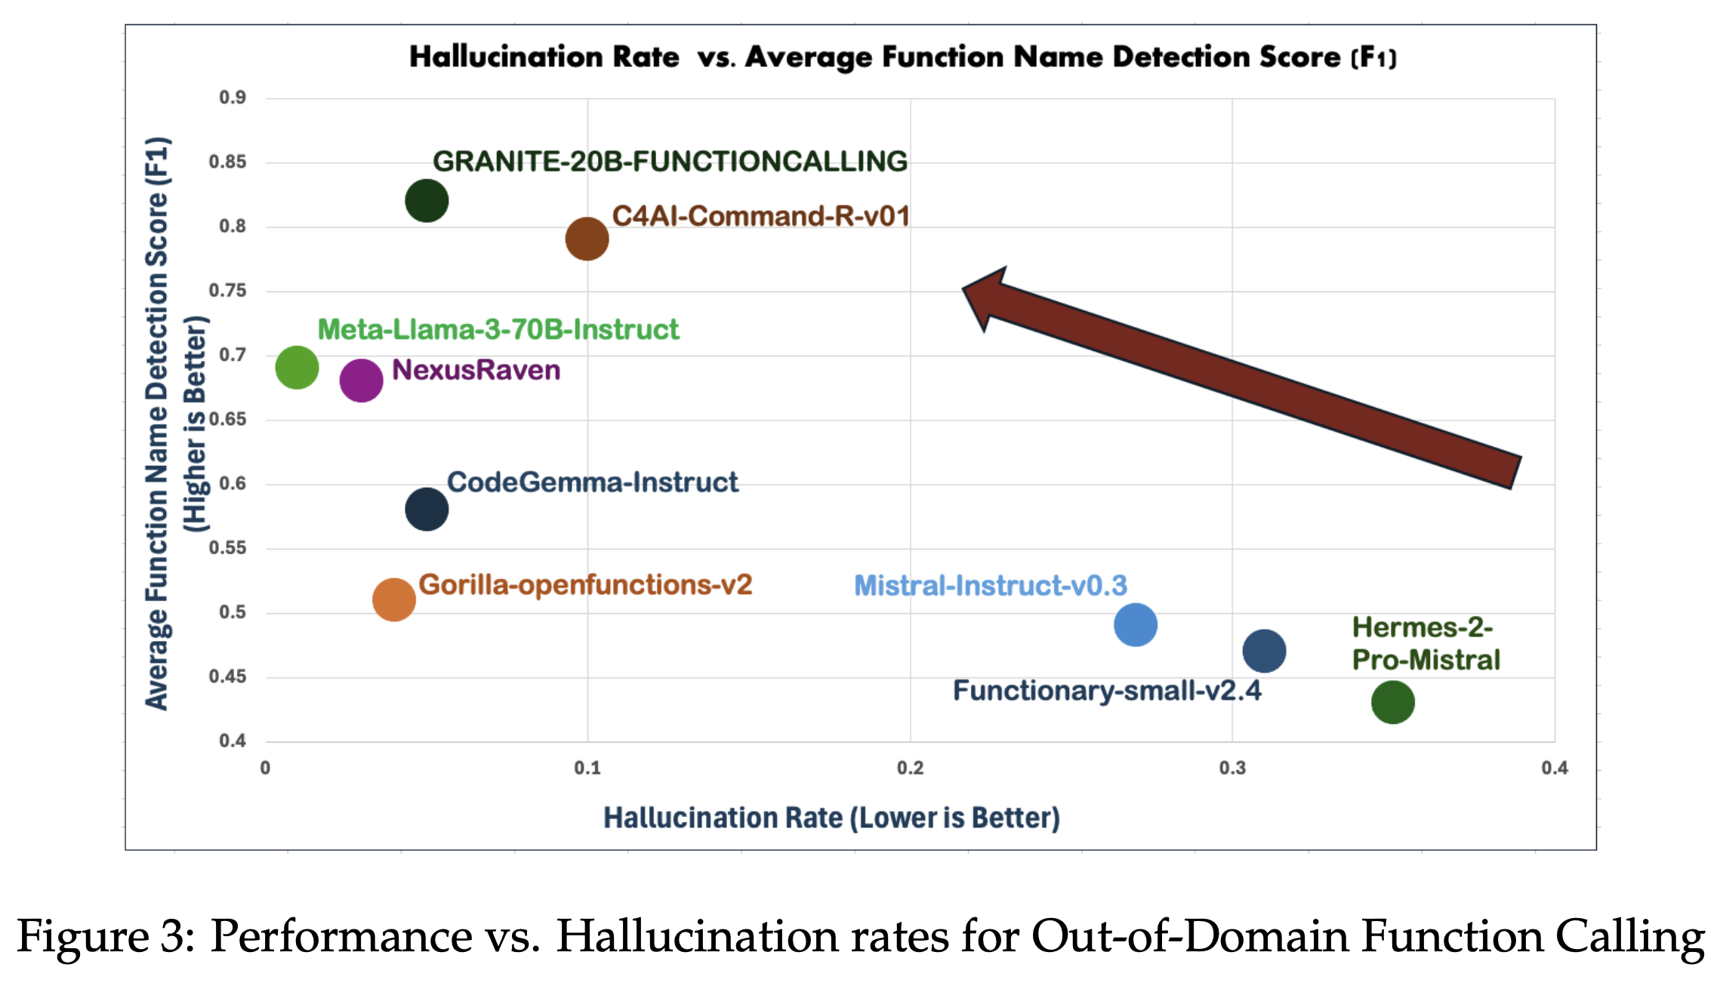
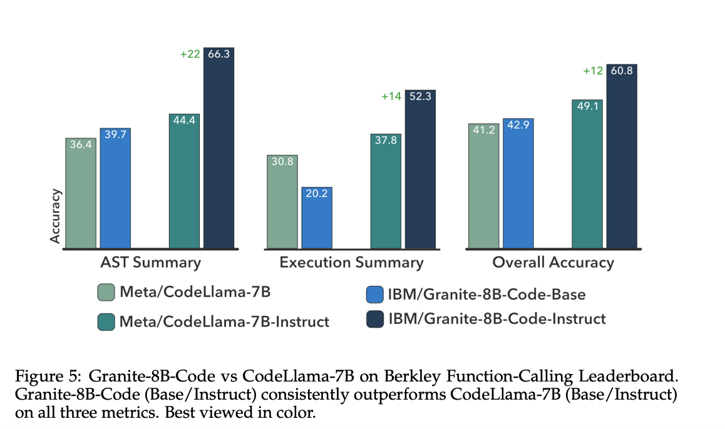
Gorilla Function Calling Benchmark
Abdelaziz, I., et al. (2024). Granite-Function Calling Model: Introducing Function Calling Abilities via Multi-task Learning of Granular Tasks. arXiv. https://arxiv.org/abs/2407.00121¯
Notes:
AST summary compares the abstract syntax tree of the function output to the ground truth and the function definition. It captures the correctness of the functions called, their parameters (required or not), and the parameter types.
Execution Summary compares the execution output from generated and ground-truth function calls. This metric is used to evaluate REST APIs and non-REST data samples.
Relevance evaluates the model’s ability to detect no function calls when the given list of functions is irrelevant to the user query. This inversely captures the hallucination rate of models.
Overall Accuracy is the weighted average of all individual data splits in BFCL.

Slide 30
Training vs. Inference Time Scaling
Made famous by o1-preview

Slide 31
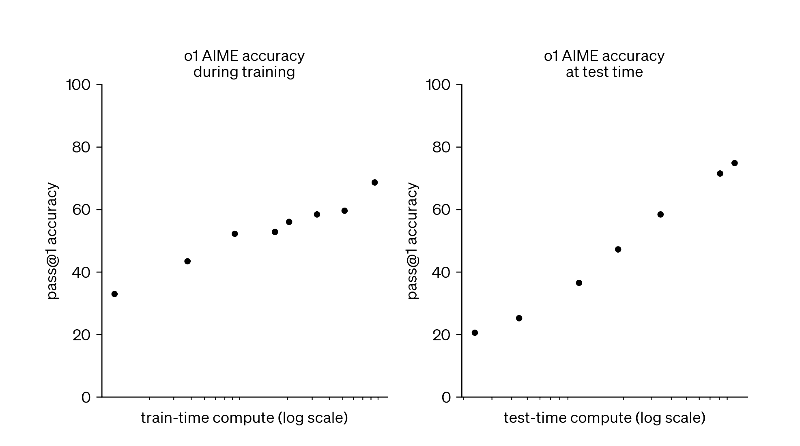
Training vs. Inference Time Scaling
Better Data
Diverse
Difficulty
Quality
SDG
Architecture
Filtering
HIL
RMs
Alignment
Search algorithms
Better and long CoTs
Agentic Behavior
Tools
ORMs and PRMs
Verification
Self-Correction
OpenAI 2024

Slide 32
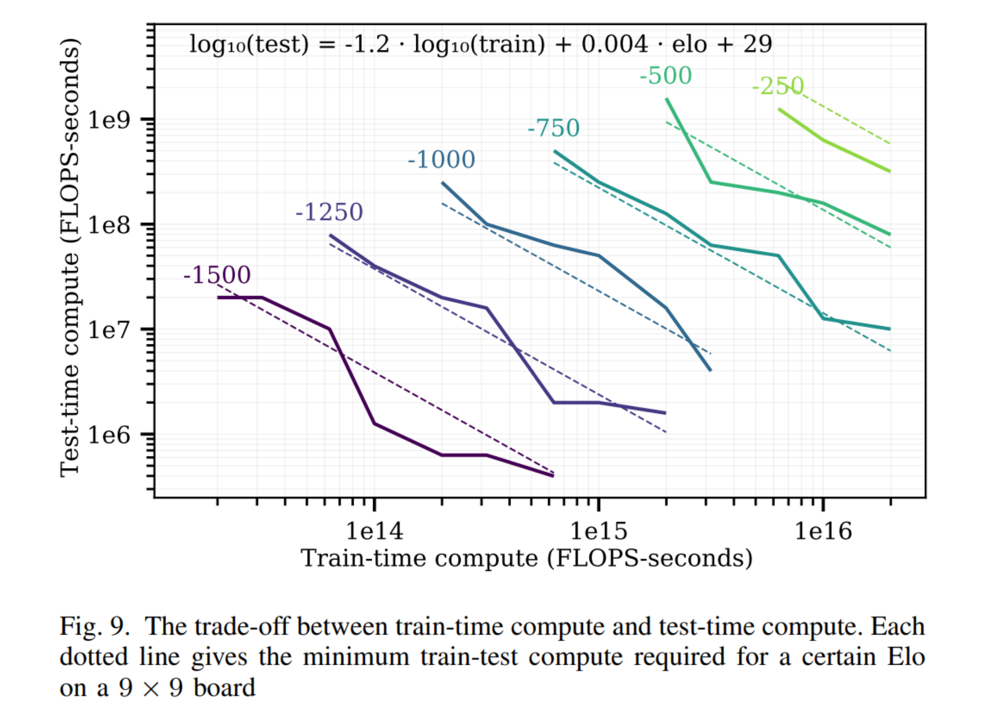
Trade-off between train and test time compute
Test time can help model Training
Scaling Laws for Board Games
We want the inference to be
Cheap, and
Speedy
Use them to improve our models in the first place
Example
Which one is heavier, 1 kg of cotton or 1 kg of steel?
Took GPT-o1-preview model 22 seconds to reply
[Jones 2021]
Image Inspired by: Sasha Rush – o1 tutorial

Slide 33

Clues from o1 Blog
“Our large-scale reinforcement learning algorithm teaches the model how to think productively using its chain of thought in a highly data-efficient training process.”
While we don’t know what exactly is going on in o1, this line from the blog provides some strong hints
RL – some reward signal
CoT – inference is long CoTs
Training (data-efficient) – high quality targeted data
So, the model is generating long coherent CoTs, and behaviors are learned instead of fed as human annotated data.

Slide 34
Various kinds of Chain of Thoughts - CoTs
Input
Input
Input
Self-consistency can improve the CoTs without the need of explicit verifier
It generate multiple thoughts and pick the most common ones by normalization and majority voting
Output
Output
Output
Simple Prompting
CoT
Self Consistency

Slide 35
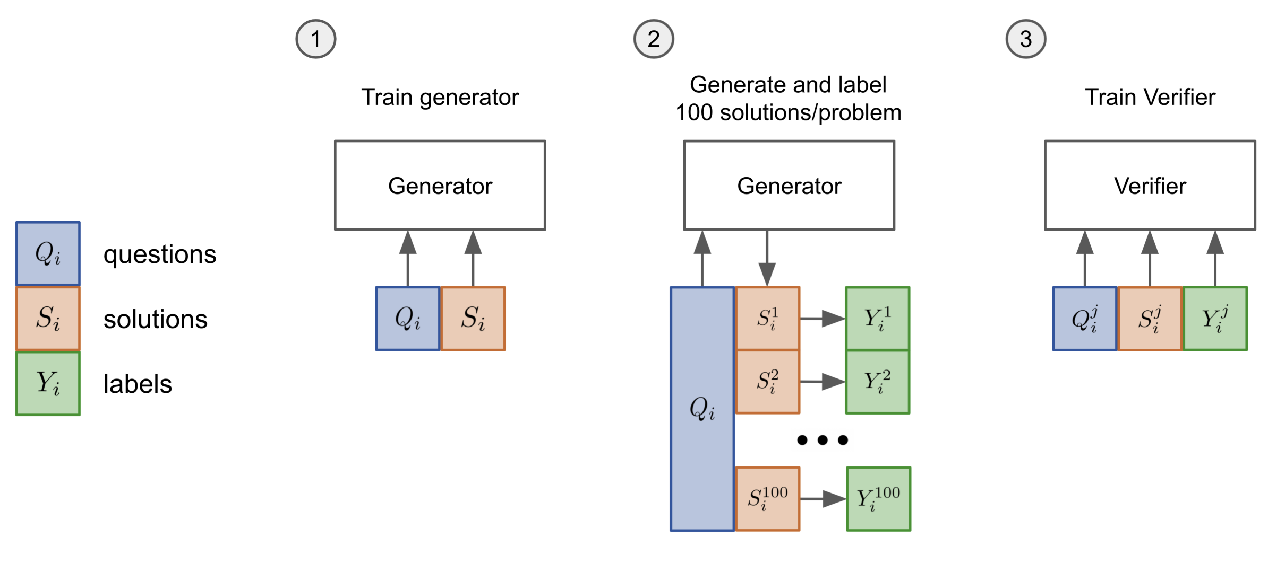
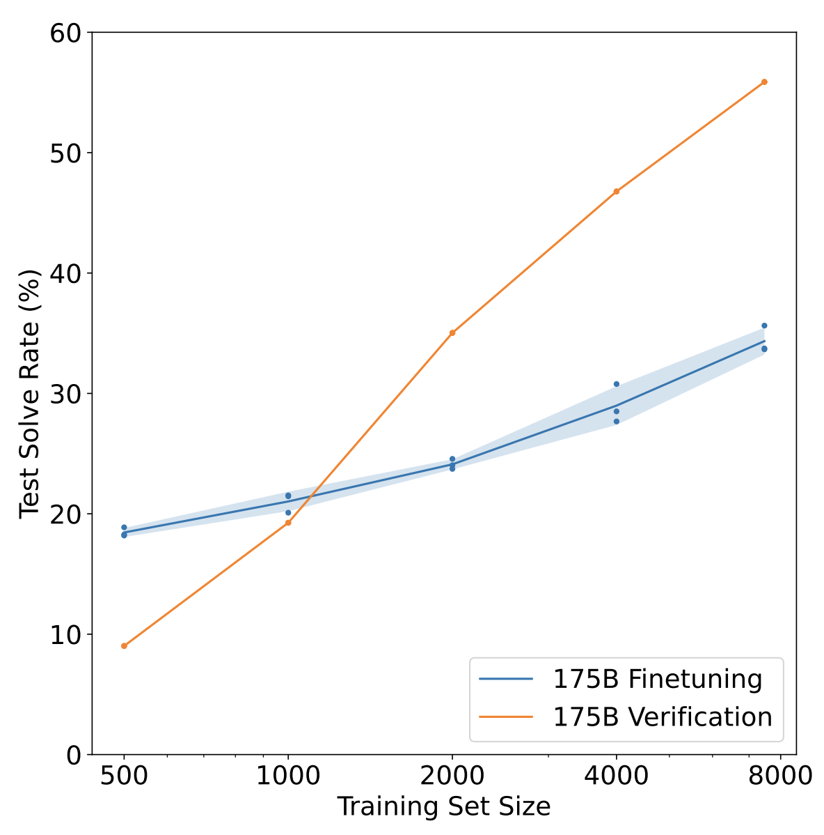
Verifiers to evaluate outcomes
Verifiers can be as simple as Regex or LLM as a judge
Learned verifiers has received a lot of tracking in recent years
Reward models are also a type of verifiers (ORMs, PRMs)
Inject new signal to the model to improve during test time
K Cobbe et al., Training Verifiers to Solve Math Word Problems
Slide Inspired by: Sasha Rush – o1 tutorial

Slide 36
Advanced CoTs by using Verifiers
Input
Input
Input
Output
Tree of Thought
Best of N
Monte-Carlo Roll-outs to check each step of CoT

Slide 37
Use CoTs to train a model
Input
Now, we would like to learn a model from these CoTs
We want a model to generate good verified solutions as frequently as it can
This is combinatorically hard problem
Maximum Likelihood Problem
Slide Inspired by: Sasha Rush – o1 tutorial

Slide 38
Generate Long coherent CoTs
Human Annotations
Guess + Check
Process Rewards
Monte Carlo Tree Search
Long self-correcting CoTs

Slide 39
Self-correcting CoTs
Input
Input
Stream of CoTs allow the model to make mistakes and then fix them
Training the model with such CoTs will not be Trivial
Output
Output
Tree of CoTs
Stream of CoTs

Slide 40
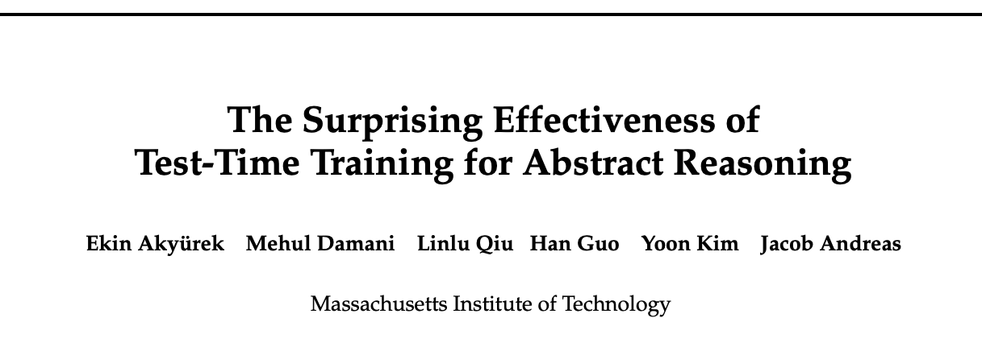
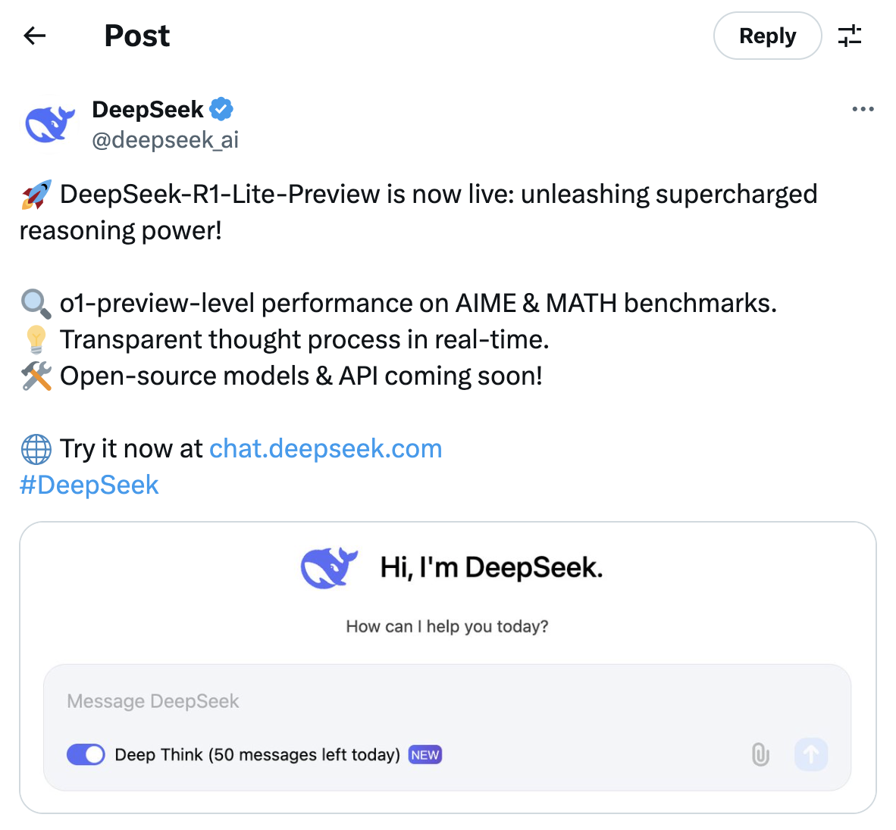
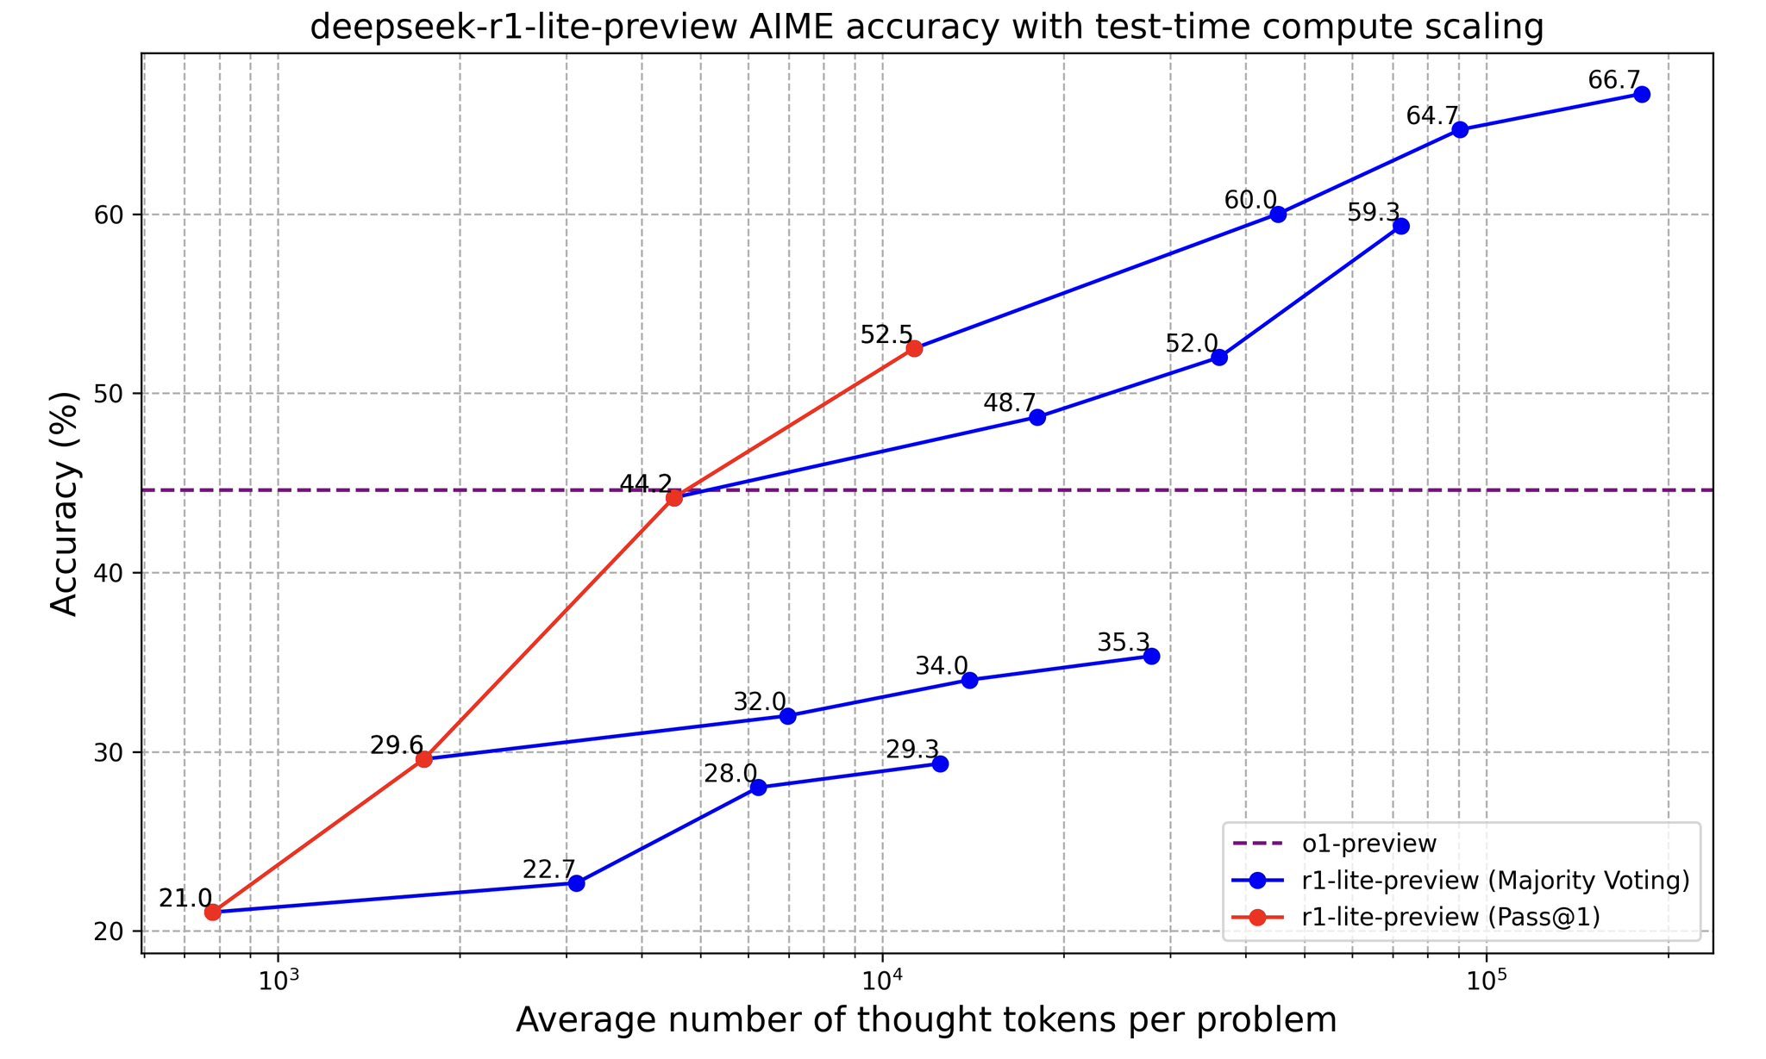
Was o1 the holy grail?
11 Nov 2024
“We investigate the effectiveness of test-time training (TTT)—updating model parameters temporarily during inference using a loss derived from input data—as a mechanism for improving models’ reasoning capabilities, using the Abstraction and Reasoning Corpus (ARC) as a benchmark.”

Slide 41
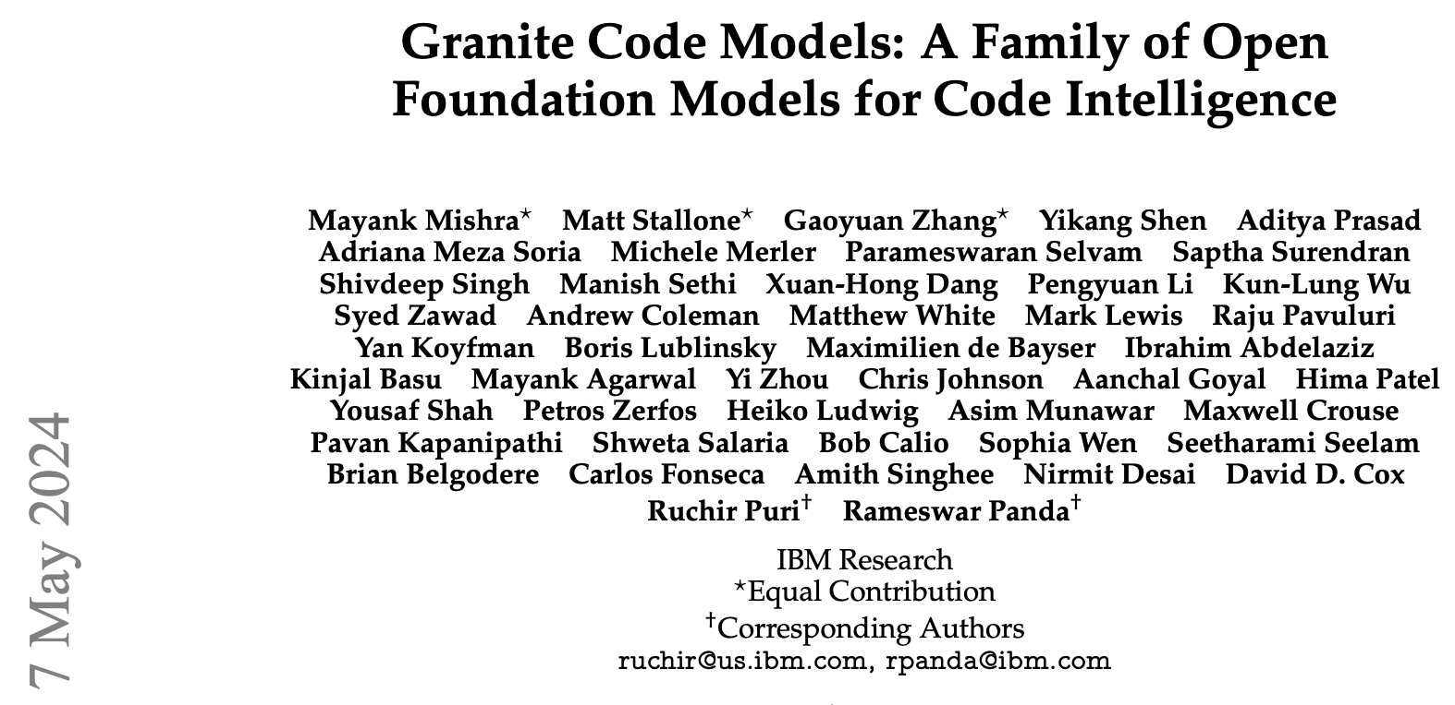

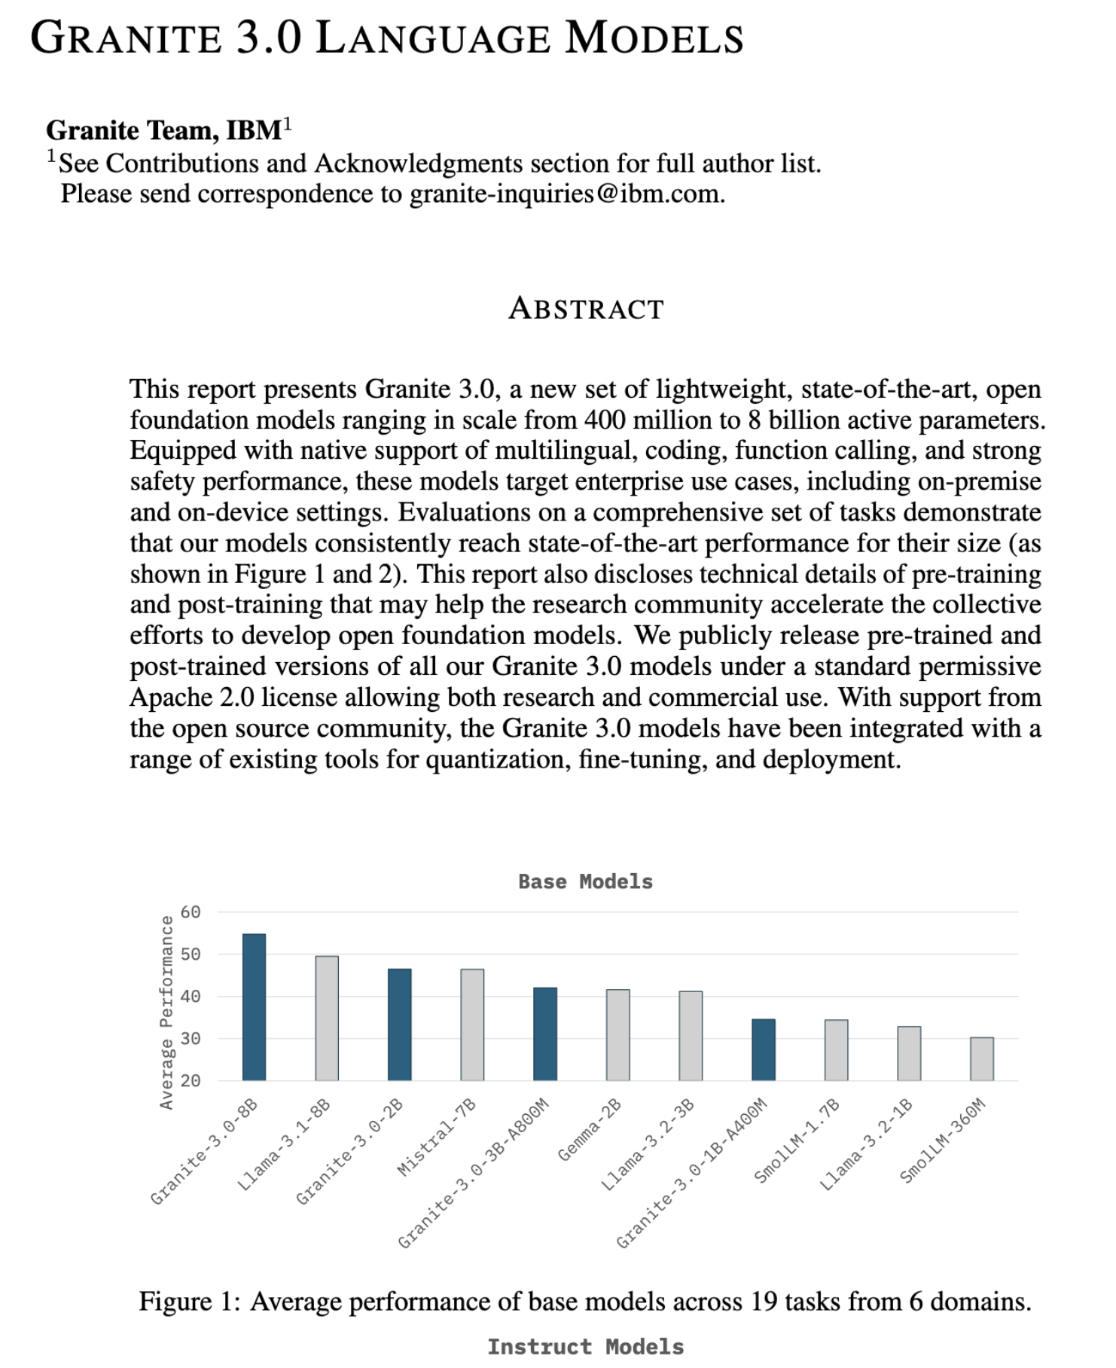
IBM Granite Models and More
October 2024

Slide 42
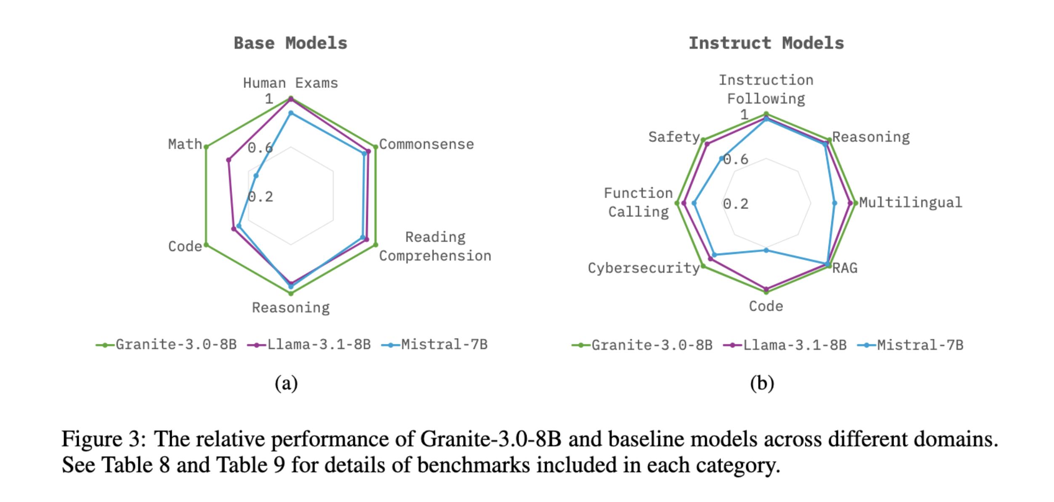
IBM Granite 3.0
State-of-the-art, light weight open foundation models ranging in scale from 400 million to 8 billion active parameters.
Native support of multilingual, coding, function calling, and strong safety performance
Target enterprise use cases
Evaluations on a comprehensive set of tasks
Transparency in data/training/architecture

Slide 43
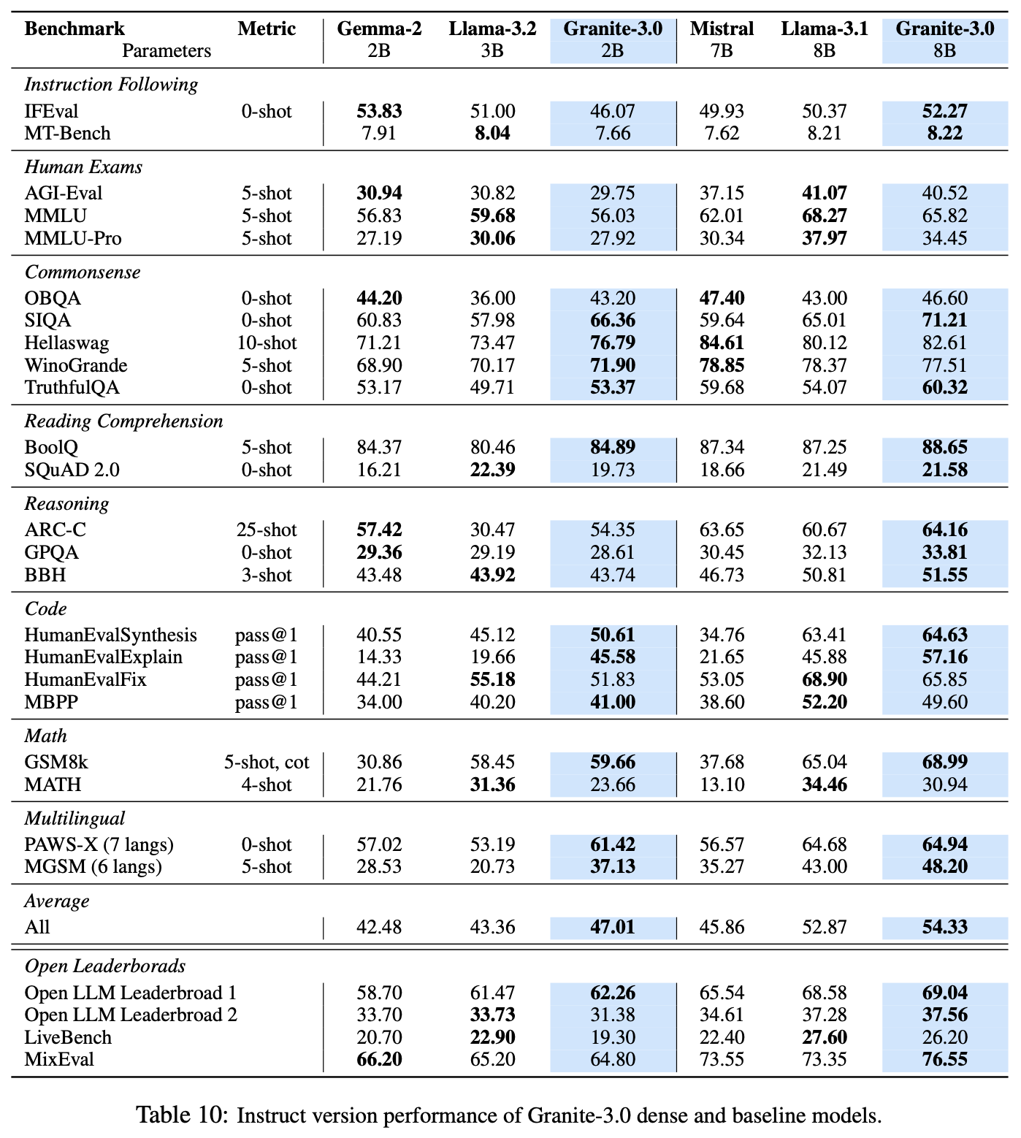
Granite 3.0
Results on Reasoning Benchmarks

Slide 44
Conclusions
LLMs have shown remarkable reasoning capabilities, but there are some serious limitations
LLMs are not used as next token predictors anymore, allowing them to go beyond emergent abilities
Ongoing Research
High quality synthetic data
Agentic behavior with external tools
Inference time vs. Train time compute
RLHF/RLAIF
Future Focus
Neuro-Symbolic AI
Architectural changes
Knowledge and World models
Better benchmarks focused on real world problems
True explainability

Slide 45


Thank you
connect with me
youtube.com/@asimmunawar
x.com/asimunawar
linkedin.com/in/asimmunawar
Asim Munawar

